Slide 1
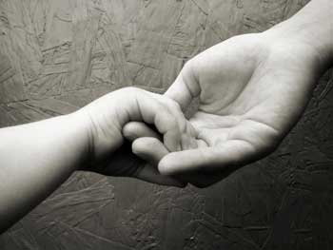
Selflessness Leads to Unity
Philippians 2:1-4
Rick Griffith • Crossroads International Church BibleStudyDownloads.org

Slide 2
A Real Test for Us...

Slide 3
Annual General Meeting 27 Mar 2011

Slide 4
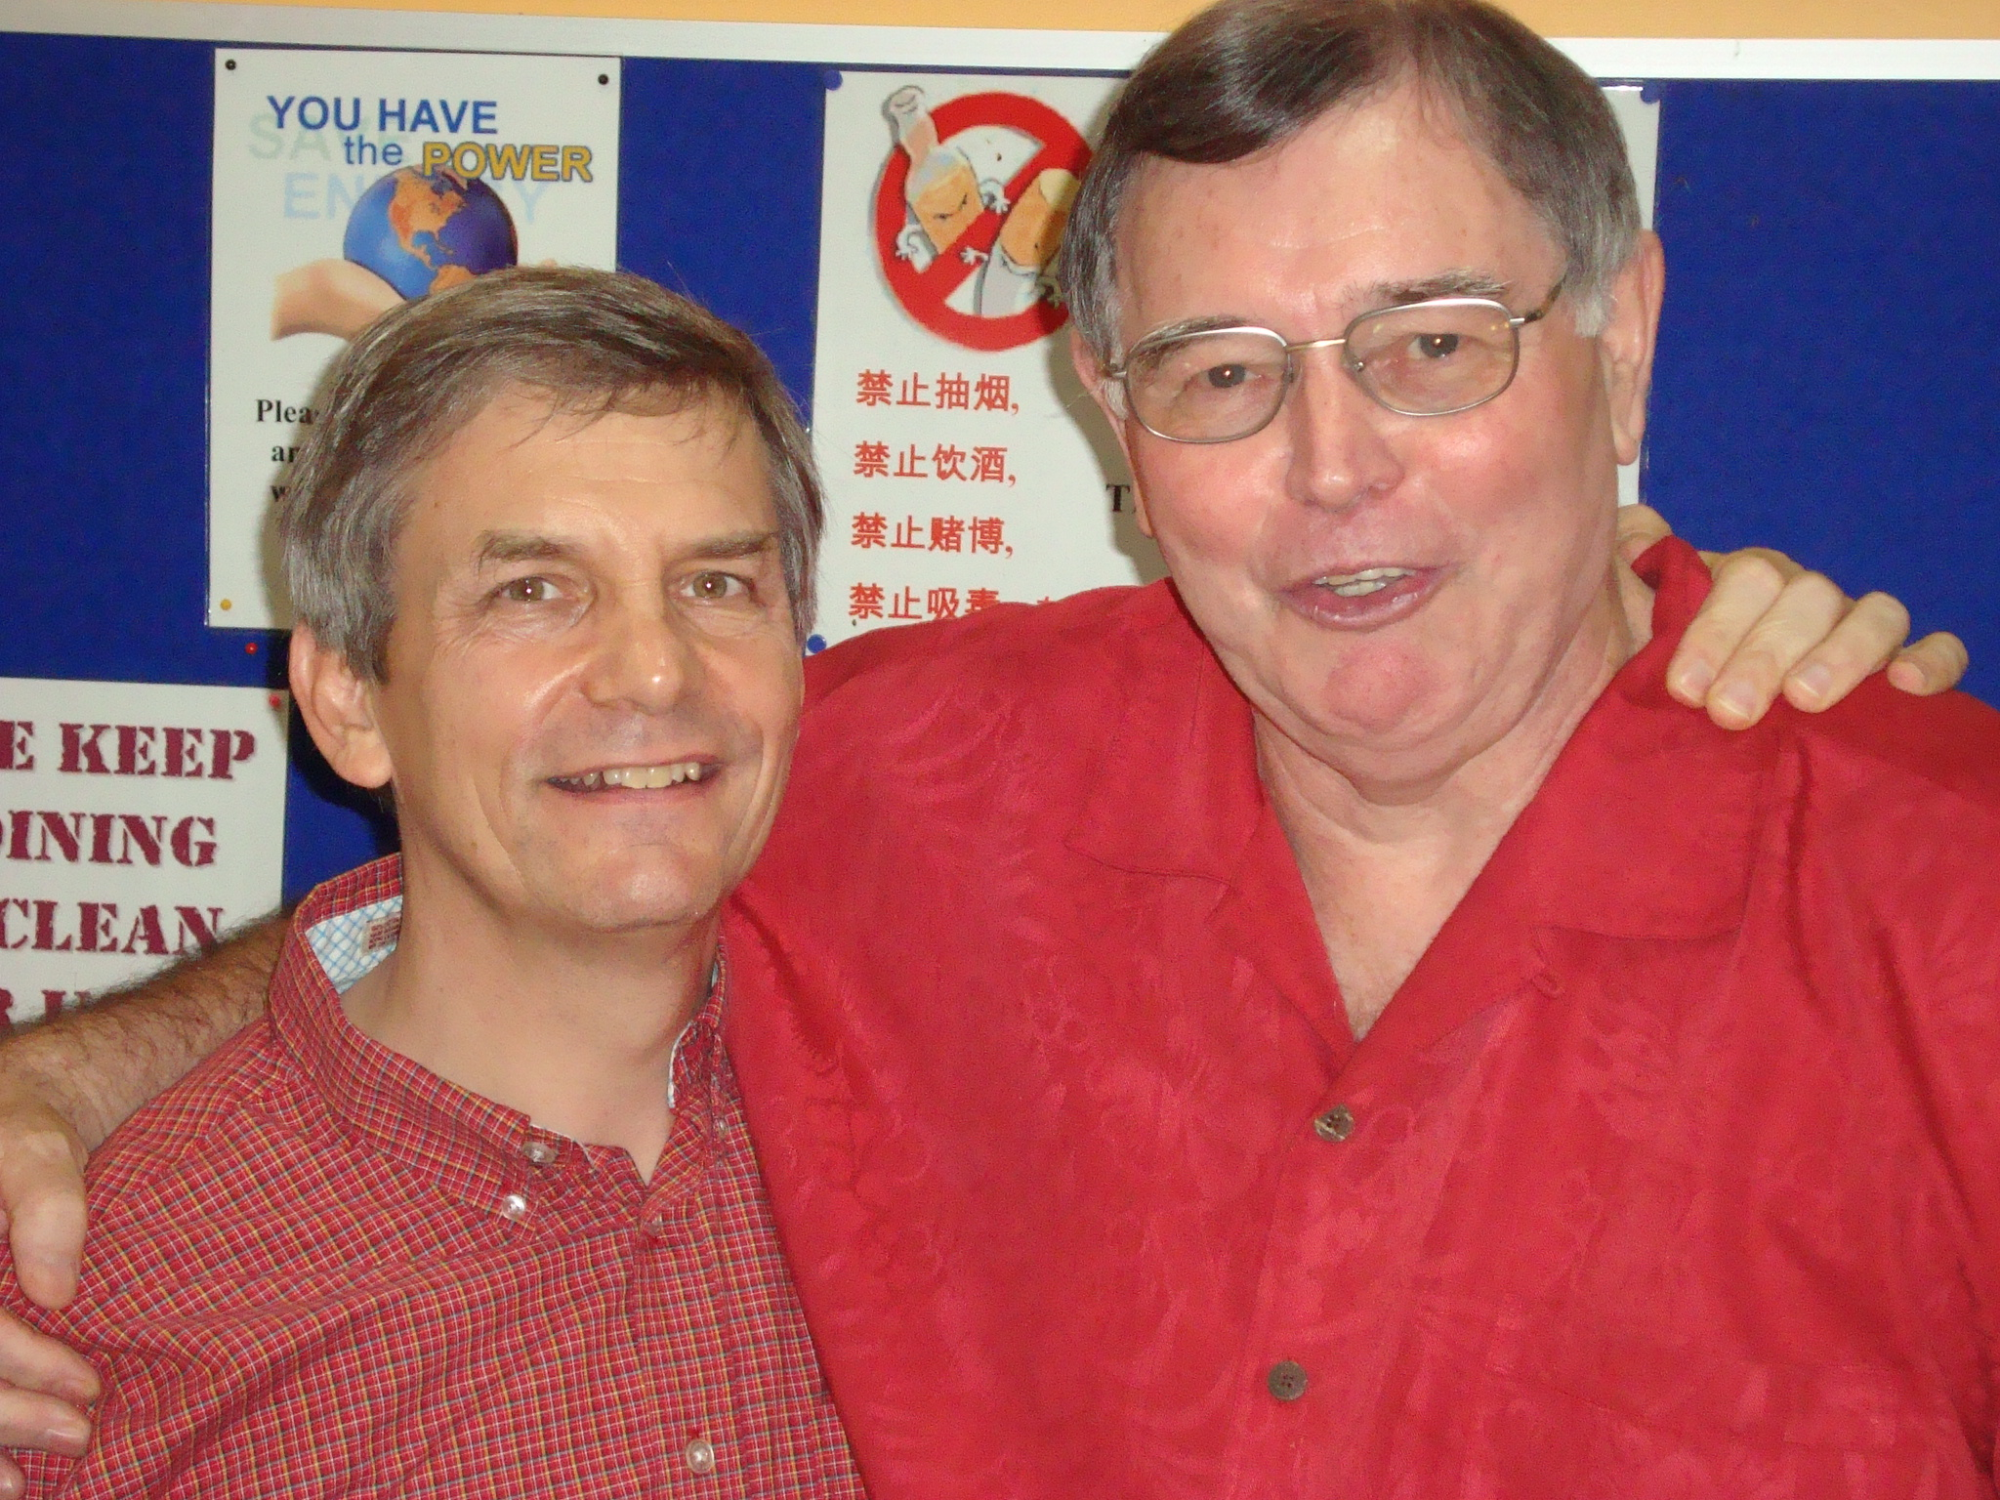
Rick Griffith & Tom Chandler
Both Directors/Elders for 2 terms each of 2 years from 24 May 2007-24 May 2011

Slide 5
Articles of Association
Our Changes Needed
Extend elder 2 terms to 3 terms
Eliminate pastor term limit
Let me know if you want a copy now!
Notes:
5
5

Slide 6
Constitution Changes Proposed
Present:
Proposed:
25. An Elder shall serve his office for a term of two (2) years and up to a maximum of two (2) consecutive terms after which he will step down for one (1) term and will be eligible to be elected to hold office as an Elder.
25. An Elder shall serve his office for a term of two (2) years and up to a maximum of three (3) consecutive terms after which he will step down for one (1) term and will be eligible to be elected to hold office as an Elder. Where an Elder also serves as Pastor of the Church, there shall be no limit to his term of office as an Elder.
75% Vote Needed!

Slide 7
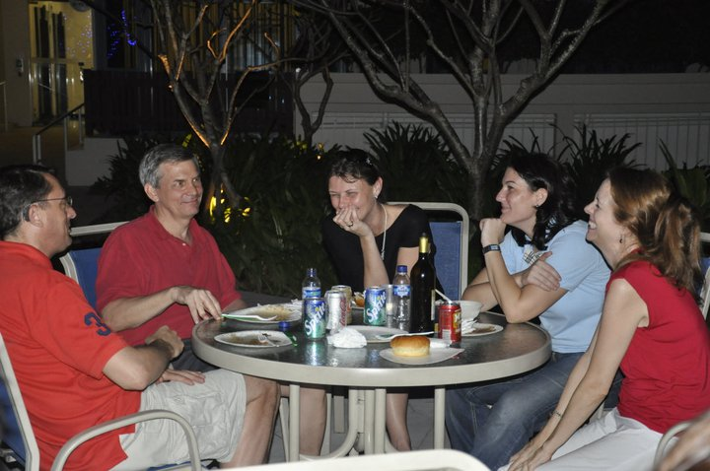
Our People on 27 March 2011
73 people from 16 nations
34 members from 16 nations

Slide 8
34 Voting Members
26 Votes Needed
26 Votes Secured!
All 100%!

Slide 9
Votes Over the Years
4 budgets
4 pastors
All 100%!
4 annual reports
4 auditors
4 elders
1 clerk
2 deacons

Slide 10
How can this church maintain its unity?
Australia
Canada
China
France
Germany
Hong Kong
India
Indonesia
Korea
Mongolia
Netherlands
Philippines
Singapore
Thailand
Vietnam
UK
USA
USA = 23%
NETH = 14%
SIN = 14%
Notes:
10
So far, we have ministered to friends from 25 nations, though only people from 10 countries are presently with us.
23% are Americans, 14% Singaporeans, 14% Dutch, and one person each come from…[read]
People from another 15 countries have been with us in the past from these nations at the right.

Slide 11
I. Selflessness leads to unity (2:1-4).

Slide 12
The Text of 2:1-4 (NASB)
Therefore if there is any encouragement in Christ, if there is any consolation of love, if there is any fellowship of the Spirit, if any affection and compassion,
make my joy complete by being of the same mind, maintaining the same love, united in spirit, intent on one purpose.
Do nothing from selfishness or empty conceit, but with humility of mind regard one another as more important than yourselves;
do not merely look out for your own personal interests, but also for the interests of others.
Notes:
Note in verse 4 that the New American Standard Bible (NASB 1977 and NASB Updated 1995) translators added the word “merely” and so it appears in italics. It is not in the Greek text, but they felt it makes the sense clearer. However, the original makes complete sense to say that all we do should be for the sake of others—even brushing our teeth and eating properly and getting enough exercise and sleep can ultimately be for others as these activities prolong our lives to enable us to serve other people!

Slide 13
The Greek of 2:1-4
Εἴ τις οὖν παράκλησις ἐν χριστῷ, εἴ τι παραμύθιον ἀγάπης, εἴ τις κοινωνία πνεύματος, εἴ τις σπλάγχνα καὶ οἰκτιρμοί, ² πληρώσατέ μου τὴν χαράν, ἵνα τὸ αὐτὸ φρονῆτε, τὴν αὐτὴν ἀγάπην ἔχοντες, σύμψυχοι, τὸ ἓν φρονοῦντες· ³ μηδὲν κατὰ ἐρίθειαν ἢ κενοδοξίαν, ἀλλὰ τῇ ταπεινοφροσύνῃ ἀλλήλους ἡγούμενοι ὑπερέχοντας ἑαυτῶν· ⁴ μὴ τὰ ἑαυτῶν ἕκαστος σκοπεῖτε, ἀλλὰ καὶ τὰ ἑτέρων ἕκαστος.
The New Testament in the Original Greek: Byzantine Textform 2005, With Morphology (Bellingham, WA: Logos Research Systems, 2006), Php 2:1-4.

Slide 14
My Translation of 2:1-4
Therefore if there is any encouragement in Christ, if there is any consolation of love, if there is any fellowship of the Spirit, if any affection and compassion,
make my joy complete by being of the same mind, maintaining the same love, united in spirit, intent on one purpose,
doing nothing from selfishness or empty conceit, but with humility of mind regarding one another as more important than yourselves,
not merely looking out for your own personal interests, but also for the interests of others.

Slide 15
The Structure of 2:1-4 (NASB)
Therefore if there is any encouragement in Christ, if there is any consolation of love, if there is any fellowship of the Spirit, if any affection and compassion,
make my joy complete by being of the same mind, maintaining the same love, united in spirit, intent on one purpose.
Do nothing from selfishness or empty conceit, but with humility of mind regard one another as more important than yourselves;
do not merely look out for your own personal interests, but also for the interests of others.
4 “if” phrases: “Please...”
Main Verb: “give me joy...”
4 “by” phrases: “by being united...”
2 commands: “from being selfless”

Slide 16
Selflessness leads to unity (2:1-4).

Slide 17
Attitude words in 2:1-4 (NASB)
Therefore if there is any encouragement in Christ, if there is any consolation of love, if there is any fellowship of the Spirit, if any affection and compassion,
make my joy complete by being of the same mind, maintaining the same love, united in spirit, intent on one purpose.
Do nothing from selfishness or empty conceit, but with humility of mind regard one another as more important than yourselves;
do not merely look out for your own personal interests, but also for the interests of others.

Slide 18
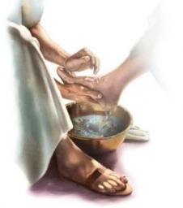
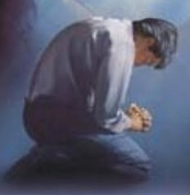
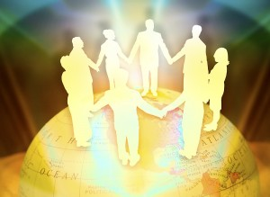
The Sequence
Selflessness
Humility
Unity

Slide 19
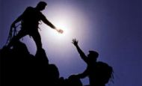
Two Ways to Relate to Others Philippians 2:1-4
186d
Selfish
Selfless
Produces grumbling (2:14)
Produces joy (2:2a)
Leads to division (4:2)
Leads to unity (2:2b)
Proud (2:3a)
Humble (2:3b)
Considers self
better than others (2:3a)
Considers others
better than self (2:3b)
Looks out for self (2:4a)
Looks out for others (2:4b)
Imitates Satan
Imitates Christ (2:5)

Slide 20
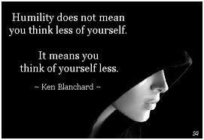
What is Humility?
Humility does not mean you think less of yourself.
It means you think of yourself less.
—Ken Blanchard—

Slide 21
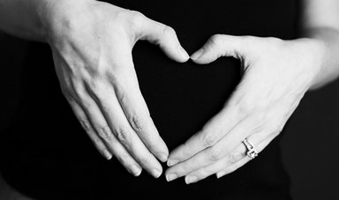
Don'ts and Do's
of Upside Down Living
³Do nothing from selfishness or empty conceit,
but with humility of mind regard one another as more important than yourselves;
⁴do not merely look out for your own personal interests,
but also for the interests of others.
Notes:
Some translations add "merely" (NASB) or "only" (NIV, NKJV, NCV, NET)

Slide 22
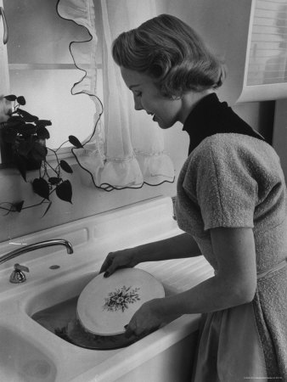
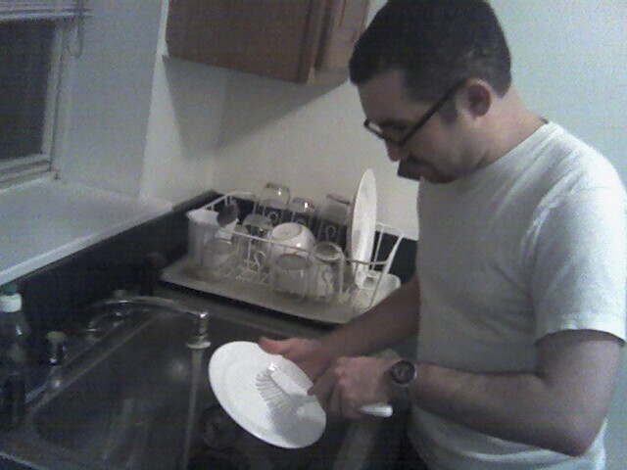
Who's to wash the dishes?

Slide 23
A rough start…

Slide 24
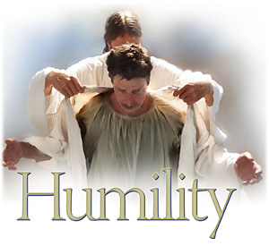
II. This church can be truly united only as long as members are truly humble.

Slide 25
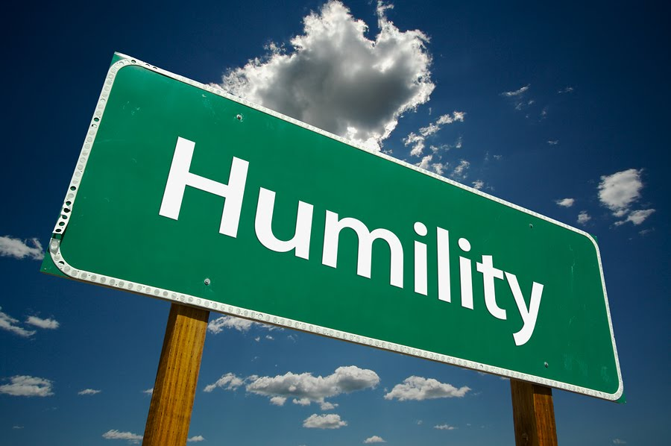
Are YOU Humble? Four questions to ask…

Slide 26
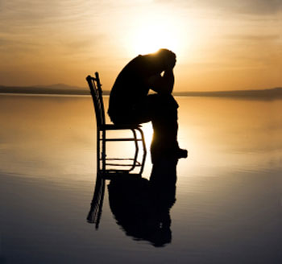
Question 1: How do you respond when someone treats you like a servant?

Slide 27
Flying First Class

Slide 28
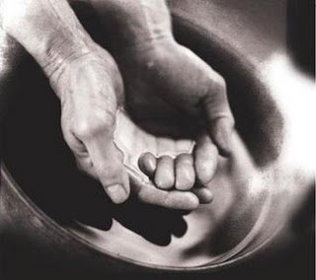
Question 2: How do you treat those who serve you?

Slide 29
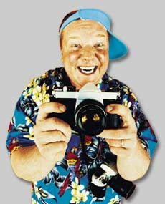
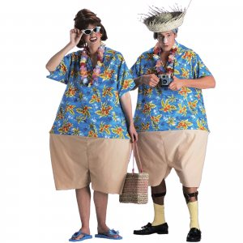
The Ugly American

Slide 30
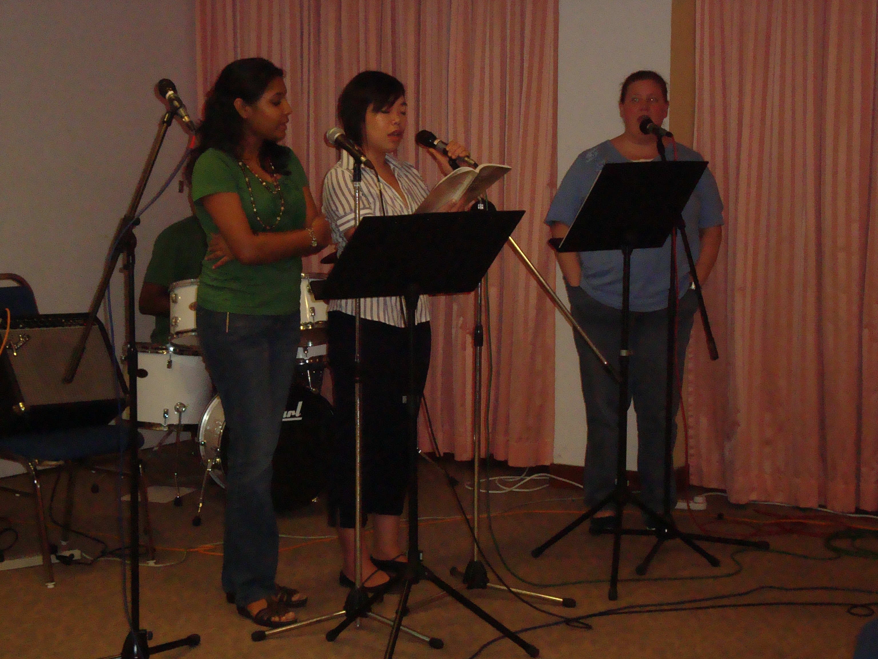
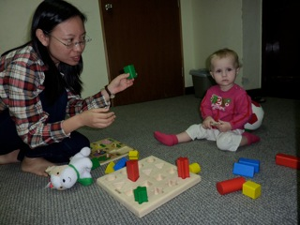
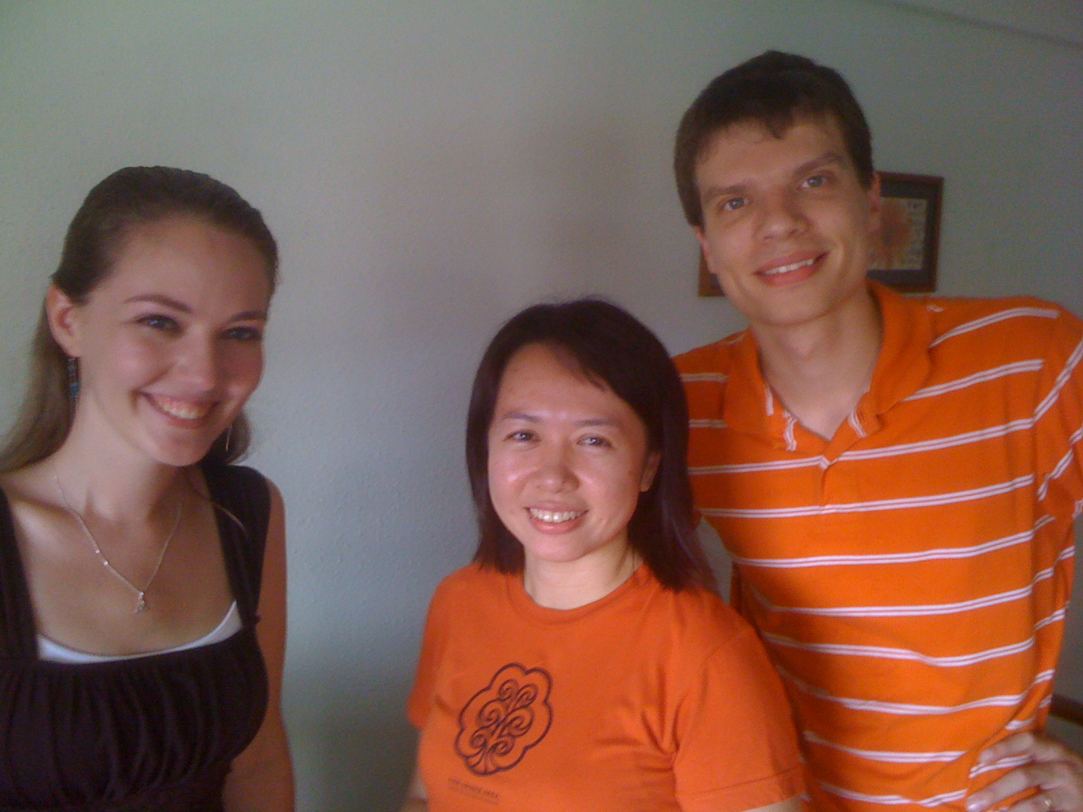
Many serve you here…

Slide 31
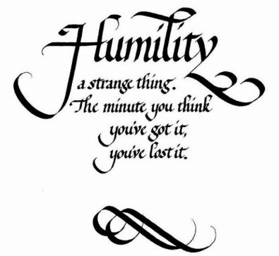
Question 3: Are you proud about your humility?

Slide 32
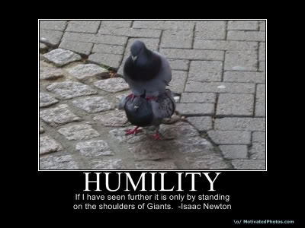
Question 3: Are you proud about your humility?
HUMILITY “If I have seen further, it is only by standing on the shoulders of giants" –Isaac Newton

Slide 33
Question 4: How much do you expect recognition?

Slide 34
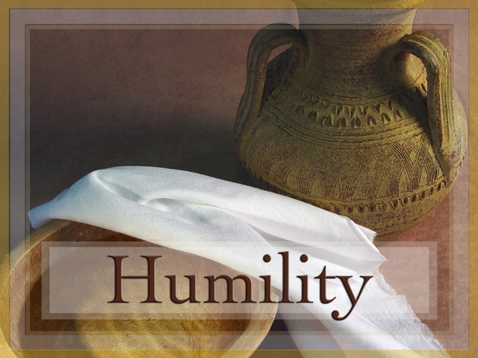
Recognition Quotes
“Do all the good you can in the world, and make as little noise about it as possible.”
“There is no limit to the good that a man can do if he doesn’t care who gets the credit.”
“When a man forgets himself, he usually does something everybody else remembers.”

Slide 35
Selflessness leads to unity (Main Idea)

Slide 36
Is your selflessness contributing to this church’s unity?
How do you respond when someone treats you like a servant?
How do you treat those who serve you?
Are you proud about your humility?
Do you care for recognition?

Slide 37
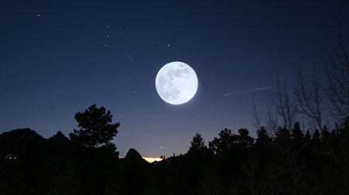
“Humility, like darkness, reveals the heavenly lights.” – Henry David Thoreau

Slide 38
Black

Slide 39
NT Preaching link at BibleStudyDownloads.org
Get this presentation and script for free!
Notes:
NT Preaching (np)

